Slide 1

So you want to learn bioinformatics huh?
By Jenna Robinson

Slide 2
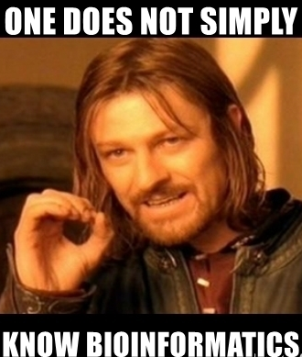
Introduction
Outline
Command line basics
2. Quality over quantity: fastqc and adaptor trimming
3. Alignment (or finding where things belong)
4. Peak calling: ain’t no mountain high enough
5. Differential analysis
6. The rest of it: annotation, pathway enrichment and more ✨
Analysis code and useful resources can be found at:
https://github.com/jennarobinson99/MDA_bioinformatics
Get ready for a wild ride

Slide 3
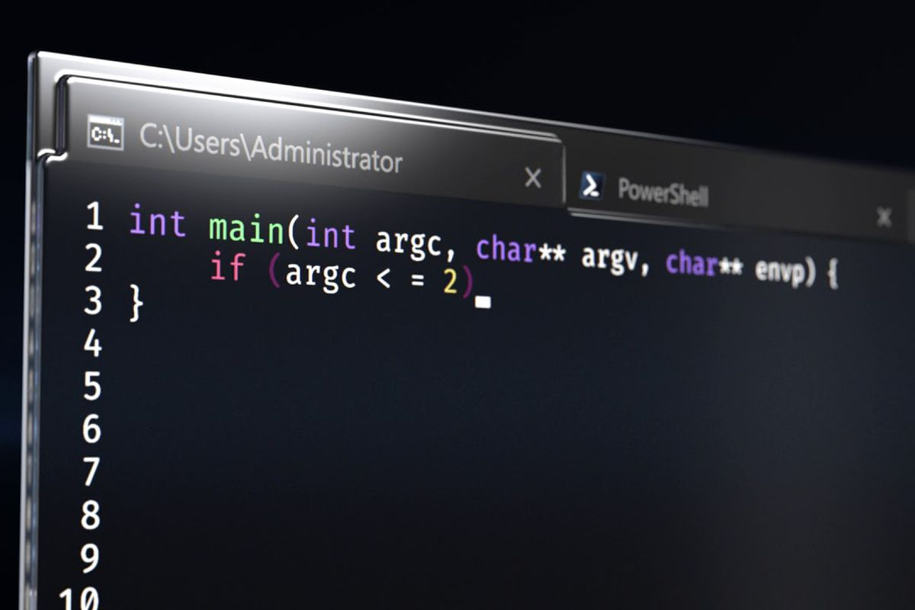

Command line basics
1.
Linux operating system
Terminal
Shell
Kernel
aka command line Where commands are typed
E.g. bash - command line interpreter
Performs the operation – dependent on computer hardware (e.g. RAM and CPU)
echo “hello world”
Computing server
Notes:
FYI you need to be connected to imperial wifi for this to work

Slide 4

Command line basics
1.
Downloading tools
Find your PATH – all the folders where the shell will search for a command
echo $PATH
To find if you have a particular tool
#NOTE - we use $ to define variables, in this case PATH is an environmental variable that tells the shell how to behave
#NOTE – do not confuse the uppercase PATH variable with the lowercase ‘path’ which defines your directory location
which fastqc
To install a new tools, use conda
module load fastqc
which fastqc
Notes:
Make directories
Ls
Cd
~ Home directory
Filezilla navigation

Slide 5
Command line basics
1.
Running batch jobs
Let’s start by making a job file that creates a next file called “test.txt” and prints numbers 123
echo “123” > test.txt
See github for how to make this a job script
vim test_job.pbs qsub test_job.pbs
qstat 6895378.pbs
Notes:
Example: add SRA toolkit
export PATH=$PATH:/data/seqtools/sratoolkit.2.8.2-1-centos_linux64/bin

Slide 6
Quality and Quantity
2.
Download files
To download fasta files, go to https://www.ebi.ac.uk/ena/browser/home and search SRR from sample sheet
Copy link address of “generated FASTQ files”
Download via wget e.g.
wget -O hacat_bg4_Rep1.fastq.gz ftp://ftp.sra.ebi.ac.uk/vol1/fastq/SRR309/000/SRR3095370/SRR3095370.fastq.gz
gunzip *.fastq

Slide 7
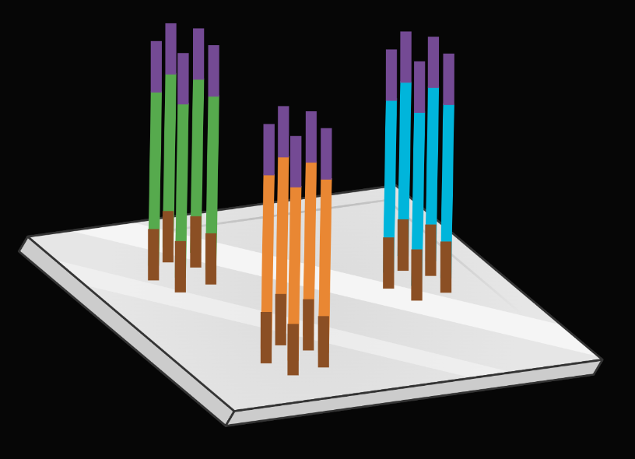
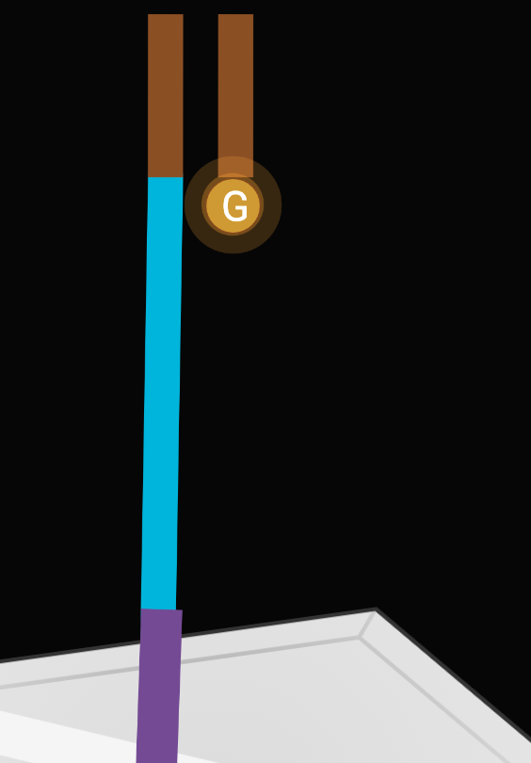
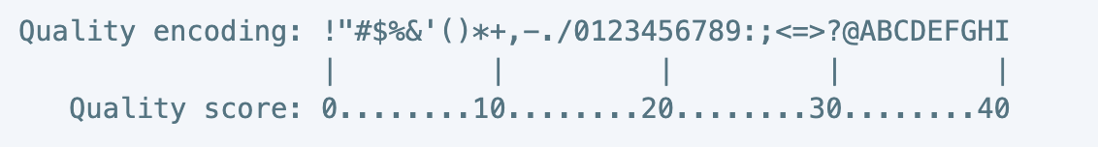
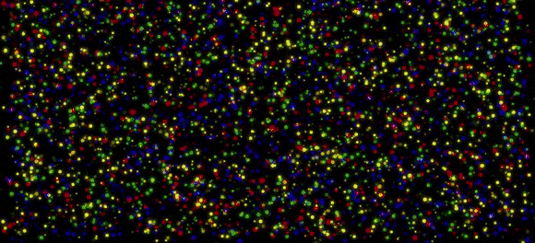
Quality and Quantity
2.
What’s in a fastq file?
Sequence ID
head hacat_bg4_Rep1.fastq
@SRR3095370.1 1/1
ACCTANTGAAGGATATCTTGGTTGCAGNTTTGNCAGTTATGAAN
+
AAA/A#<EAE/EEEEAE//EE//EEEE#EE/A#AAAE/EE/EE#
Sequence
Sequence quality score
Probability of incorrect base call is 1/P where P = 10^(Q/10)

Slide 8
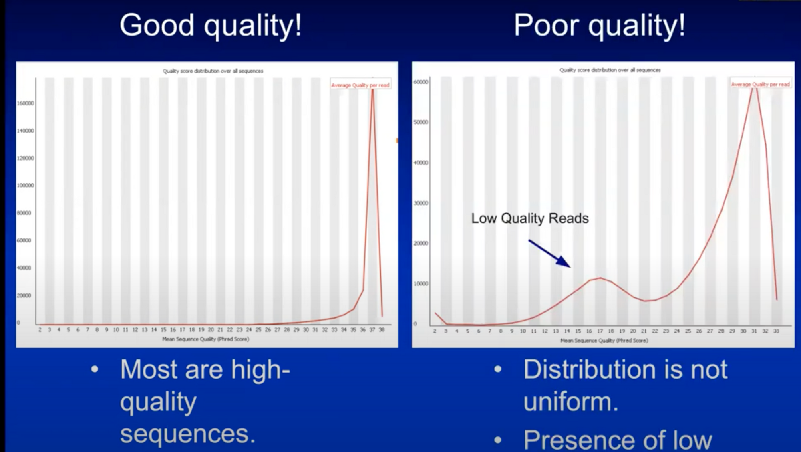
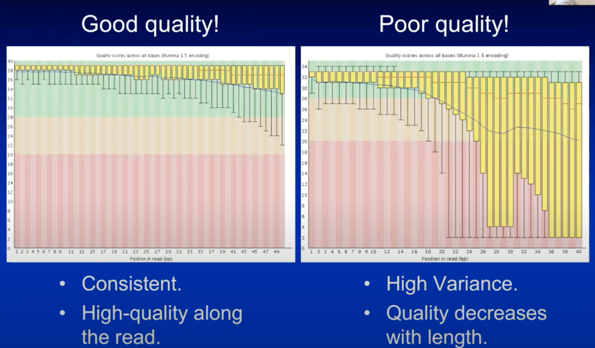
Quality and Quantity
2.
Assess quality with fastqc
#For single file
fastqc -t 12 file_name
#To batch multiple files
fastqc -t 12 *.fastq
Notes:
Recommended 30 million clean reads for BG4- ChIP

Slide 9
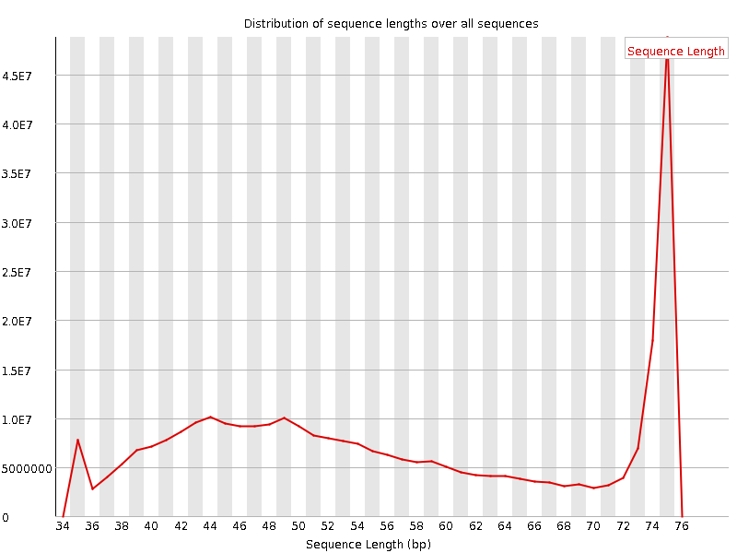
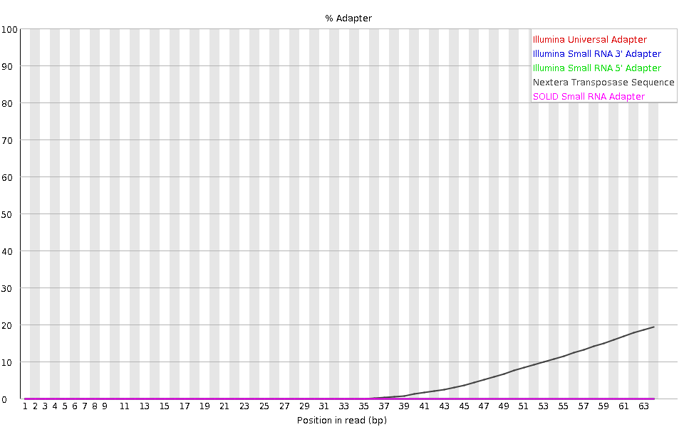
Quality and Quantity
2.
Inconsistent read length hacat_bg4_Rep1
Assess quality with fastqc
#For single file
fastqc -t 12 file_name
#To batch multiple files
fastqc -t 12 *.fastq
Sequencing of adaptors hacat_bg4_rep2_2
Notes:
Recommended 30 million clean reads for BG4- ChIP

Slide 10

Quality over Quantity
2.
Trim adaptors
If your sequence length is longer than your fragment length – you sequence some of your adaptors, which can reduce alignment quality
Cutadapt searches for and trims a specified adaptor sequence
#For single file
cutadapt -q 20 -a CTGTCTCTTATACACATCT file.fastq > file_trimmed.fastq 2> report_file.txt
# -q trims low-quality ends from reads, specify a cut-off point
# -a is the adaptor sequence to trim
# default settings for trimming are a maximum error rate of 0.1 and minimum overlap of 3 bp
#Automated code
for file in *.fastq
do
name=`basename $file .fastq`
echo starting $name
cutadapt -q 20 -a CTGTCTCTTATACACATCT $file > $name.trimmed.fastq 2> report_$name.txt echo $name done
done

Slide 11
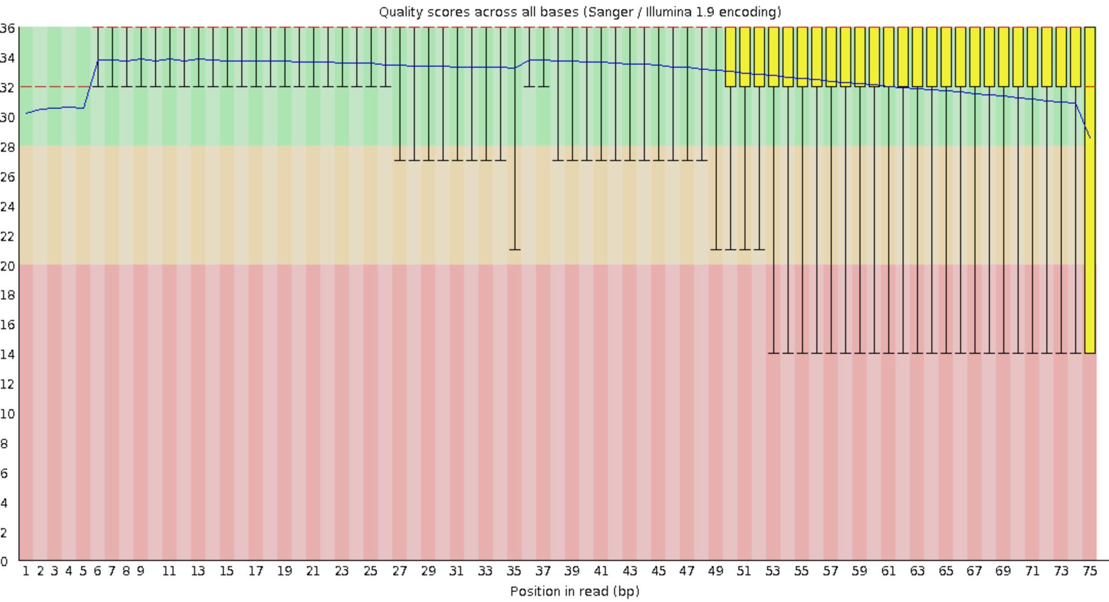
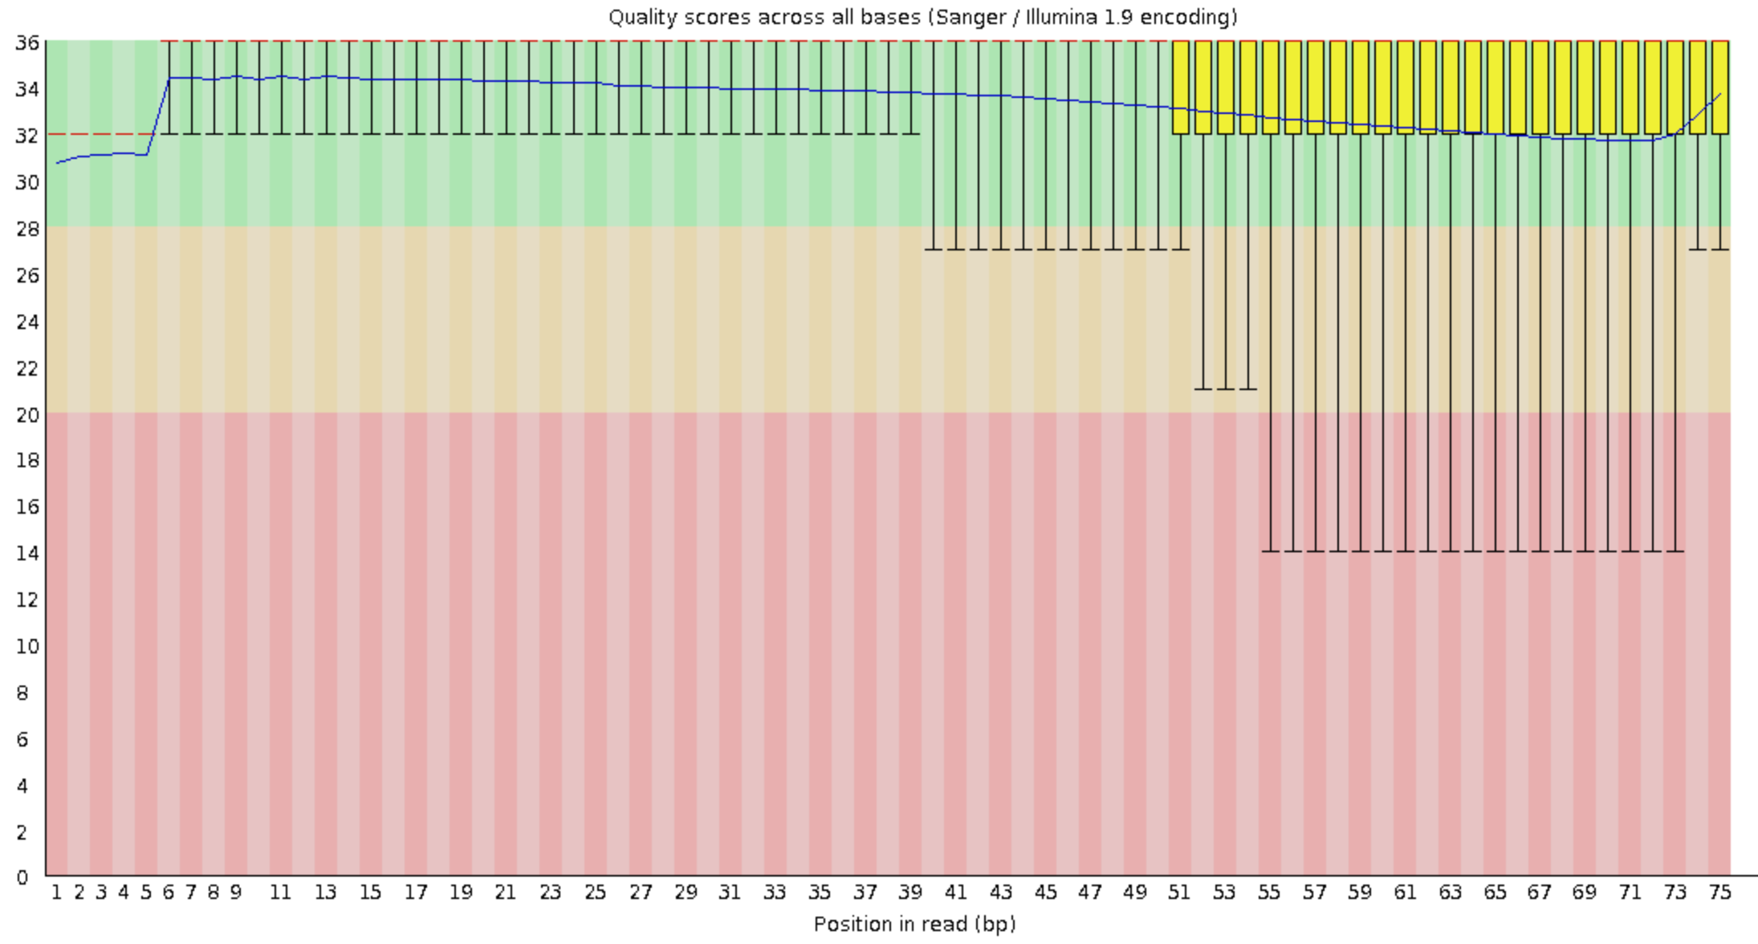
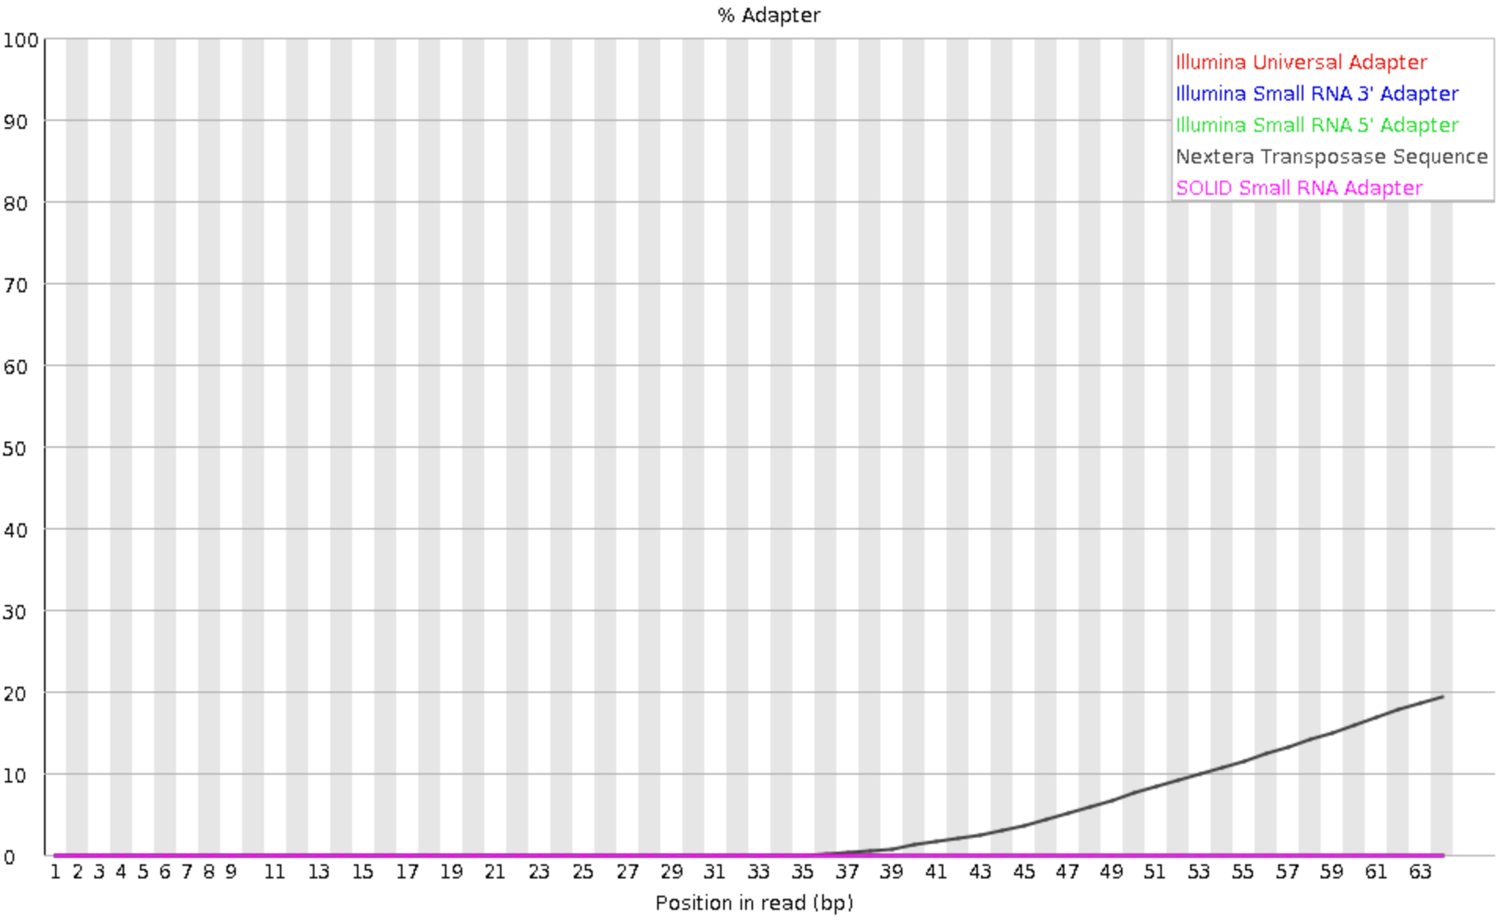
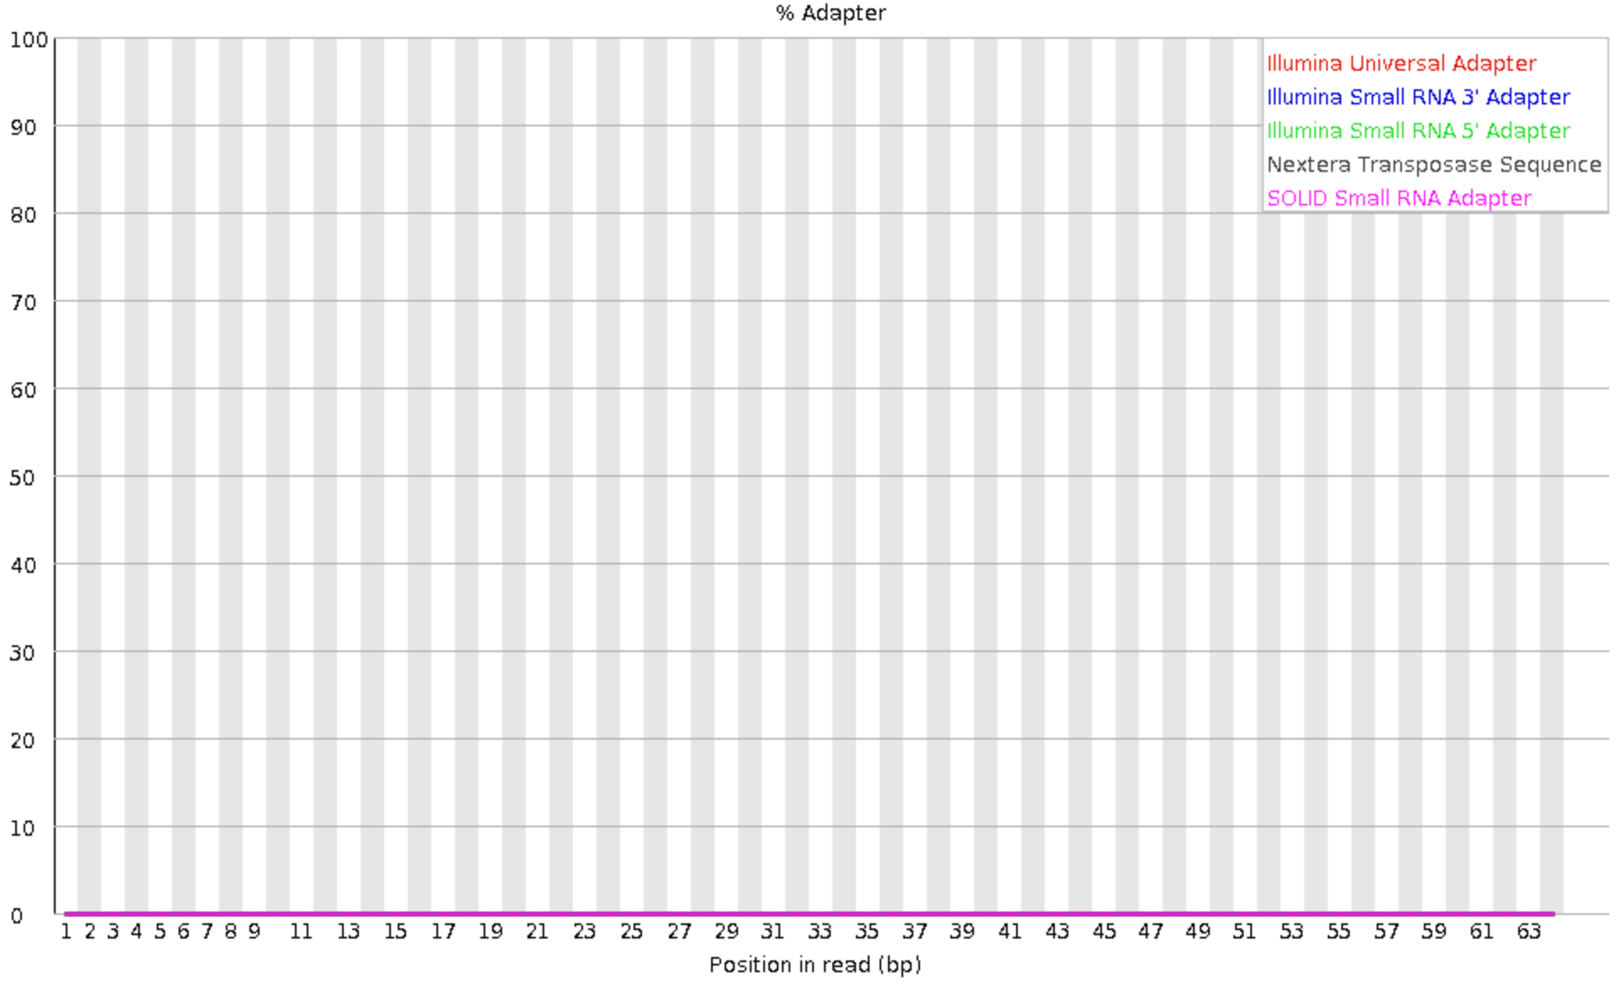
Quality over Quantity
2.
Before trimming
After trimming
Re-run fastqc
BG4_rep1
BG4_rep2_2

Slide 12
ORGANISATION
3.
1. Remove temporary files
rm *.e*
rm *.o*
4. Move fasta files to ephemeral (deleted after 30 days)
mv *.fastq /rds/general/ephemeral/user/jr2715/ephemeral
2. Make folder for fastqc, trimming, aligning
mkdir fastqc
mkdir trimmed_reads
mkdir aligned reads
3. Move files to appropriate folder
#navigate to aligning
mv ../Homo tab .
#navigate to fastqc folder
mv ../*fastqc* .
#DELETE PRE-MERGED FILES
# navigate to trimming folder
mv ../report* .
mv ../*trimmed* .
2. Move genome

Slide 13
Aligning reads
3.
Index hg38
module load anaconda3/personal
module load bowtie2
bowtie2-build /rds/general/user/jr2715/home/mda_training/aligning/Homo_sapiens.GRCh38.dna.primary_assembly.fa hg38

Slide 14
RECAP
3.
4. Merged technical replicates with cat
(check code and that combined = sum of individual)
5. Downloaded reference genome with wget
6. Index genome with bowtie2-build
Downloaded fastq files with wget
2. Assessed quality with fastqc
Analysis code and useful resources can be found at:
https://github.com/jennarobinson99/MDA_bioinformatics
3. Trimmed adaptors with cutadapt

Slide 15
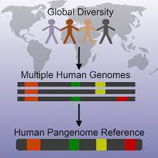
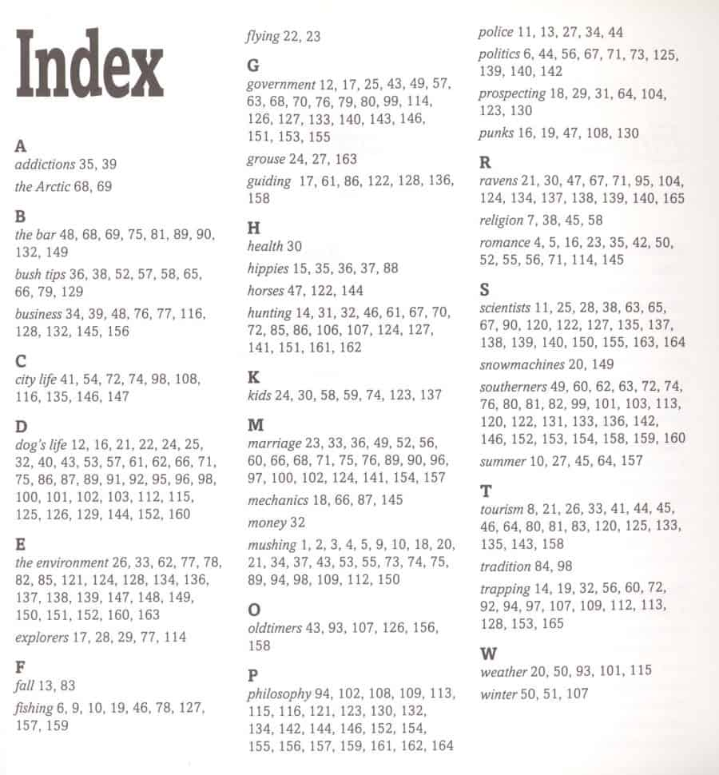
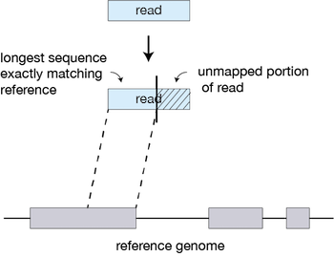
Aligning genome
3.
1. Download reference genome
2. Index genome
3. Align reads

Slide 16
Set-up personal anaconda environment
3.
Conda allows you to use tools that have dependencies on other languages e.g. Python, R, Ruby, Lua, Scala, Java, JavaScript, C/ C++, FORTRAN
#load everytime
module load anaconda3/personal
#setup only once
anaconda-setup

Slide 17
Aligning reads
3.
Align reads
1. Test bowtie2
module load anaconda3/personal
module load bowtie2
bowtie2 -a -L 5 -x /rds/general/user/jr2715/home/mda_training/aligning/hg38 -c ggagctgccatgtccgg -S test_new.sam # -a load all alignments
# -L length of seed substring
# -x reference genome
# -c sequence
# -S sam file name
2. Align reads
for file in $PBS_O_WORDIR/*.fastq
do
name=`basename $file .trimmed.fastq`
bowtie2 -x /rds/general/user/jr2715/home/mda_training/aligning/hg38 -U $file -S $name.sam 2> summary_$file.txt
done

Slide 18
Aligning reads
3.
What’s in a sam file?
Flag: e.g. 16=mapped to reverse strand http://broadinstitute.github.io/picard/explain-flags.html
CIGAR string – how many bases? Match, deletion, insertion
Start coordinate
Paired end information – name, start, insert size
Mapping quality
(0-42)
Sequence
Sample ID
Chromosome
Alignment information e.g. # of mismatches, ambiguous bases, insertions, deletions etc
Quality score

Slide 19
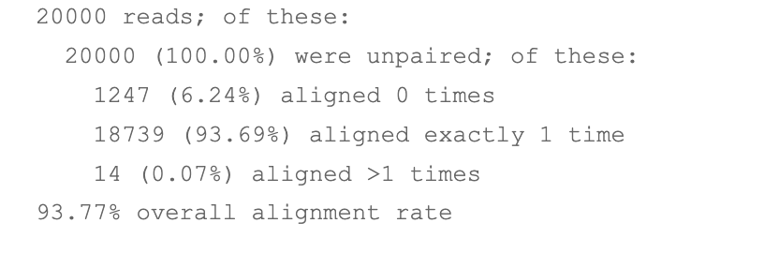
Aligning reads
3.
Quality assessment
>80% normal for human alignment

Slide 20
Aligning reads
3.
Download blacklisted regions
wget https://github.com/Boyle-Lab/Blacklist/blob/master/lists/hg38-blacklist.v2.bed.gz
gunzip hg38-blacklist.v2.bed.gz

Slide 21
Aligning reads
3.
Sam file processing -> filter, sort, deduplicate, remove blacklisted regions, index
for file in
*.sam
do
name=`basename $file .sam`
#filter unmapped, secondary and unmapped reads
samtools view -F 2308 -b -q 10 $name.sam > $name.bam
# -b output bam
# -q minimum quality score
http://broadinstitute.github.io/picard/explain-flags.html
# sort files by chromosomes and start
samtools sort -o $name.sorted.bam $name.bam
#remove duplicates
samtools markdup -r $name.sorted.bam $name.dedup.sort.bam
# remove blacklisted regions
bedtools intersect -v -abam $name.dedup.sort.bam -b '/rds/general/user/jr2715/home/mda_training/aligning /hg38-blacklist.v2.bed' > $name.bl.dedup.sort.bam
#remove intermediate files
rm $name.bam $name.sorted.bam $name.dedup.sort.bam
done
#index
samtools index $name.bl.dedup.sort.bam
Notes:
Supplementary reads removes second mapping for chimeric reads

Slide 22
What’s left to cover
Peak calling
Annotation of peaks e.g. gene body, promoter, intron etc
MOTIF enrichment
RNA-seq analysis
Differential analysis – DESeq2 and limma-voom
If interested:
Super-enhancer calling
Pathway enrichment
Data visualization: heat maps, sample clustering

Slide 23
Download blacklisted regions manually

Slide 24
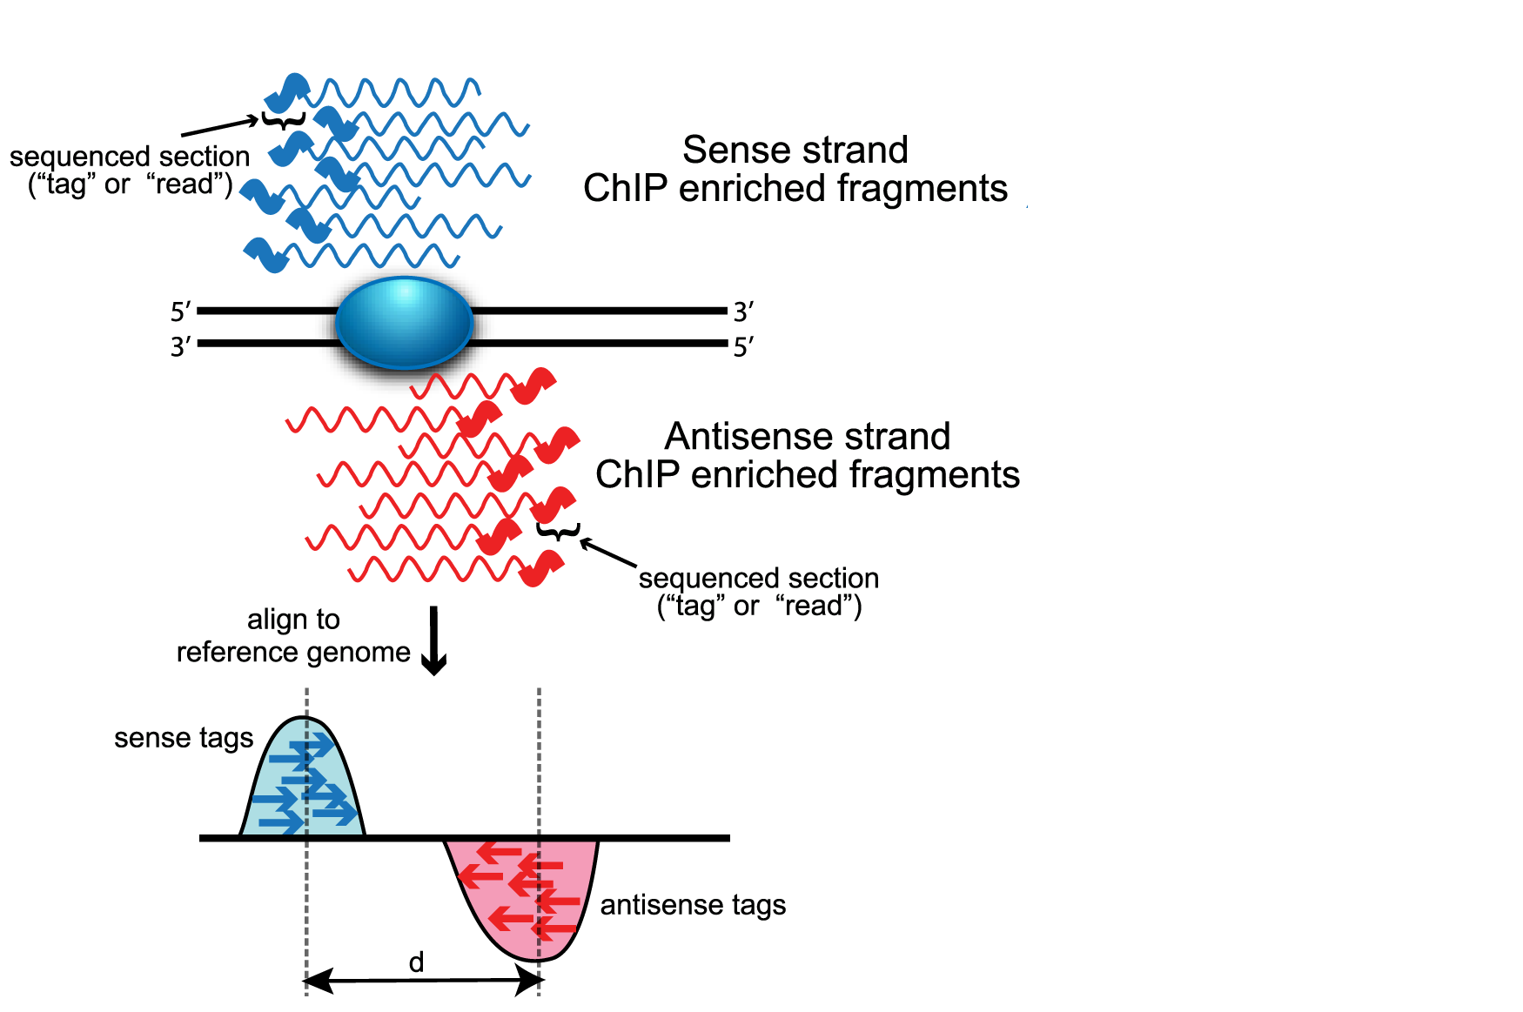
Peak calling
4.
Peak calling with MACS2
#install macs
module load anaconda3/personal
conda install -c bioconda macs2
/rds/general/user/jr2715/home/anaconda3/bin/macs2 callpeak --keep-dup all -t /rds/general/user/jr2715/home/mda_training/hacat_bg4_Rep2.bl.dedup.sort.bam -c /rds/general/user/jr2715/home/mda_training/hacat_input_Rep2.bl.dedup.sort.bam -n hacat_bg4_Rep2
#-t IP file
#-c control/input file
# -n prefix for output file

Slide 25
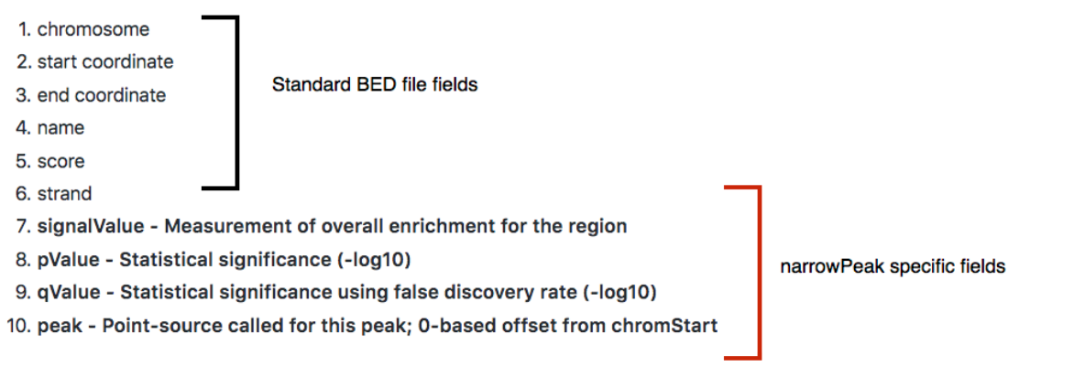
Peak calling
4.
What’s in a bed file?

Slide 26
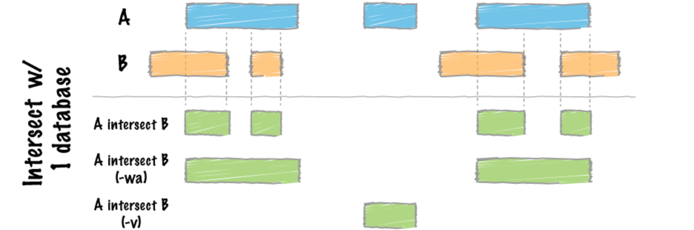
Peak calling
4.
Intersecting biological replicates
#add chr to start of each line
cat hacat_bg4_Rep1_peaks_JR.bed | sed 's/^/chr/' > new_bg4_rep1.bed
# Peaks in both replicates
module load bedtools
bedtools intersect -a new_hacat_bg4_Rep2.bed -b hacat_bg4_rep1_paper.bed > hacat_shared.bed
#Count all peaks
wc –l *.bed
How to automate?

Slide 27
Peak calling
4.
Intersecting biological replicates
#add chr to start of each line
cat hacat_bg4_Rep1_peaks_JR.bed | sed 's/^/chr/' > new_bg4_rep1.bed
# Peaks in both replicates
module load bedtools
bedtools intersect -a new_hacat_bg4_Rep2.bed -b hacat_bg4_rep1_paper.bed > hacat_shared.bed
#Count all peaks
wc –l *.bed
How to automate?
for file in *.bed
do
cat $file | sed 's/^/chr/' > new_$file
done

Slide 28
UPDATE: fastp instead of cutadapt
Automatic adapter detection
#install fastp
module load anaconda3/personal
conda install -c bioconda fastp
#run fastp
fastp –i input.R1.fq.gz -I input.R2.fq.gz -o output.R1.fq.gz –O output.R2.fq.gz --detect_adapter_for_pe -l 20 -j output.R1.fastp.json -output.fastp.html

Slide 29
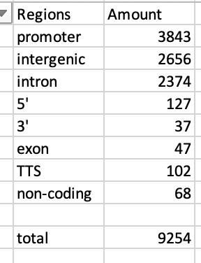
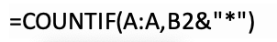
Peak annotation
module load homer
annotatePeaks.pl hacat_shared.bed hg19 > annotated_hacat_shared.bed 2> report_hacat_shared.bed

Slide 30
Peak annotation

Slide 31
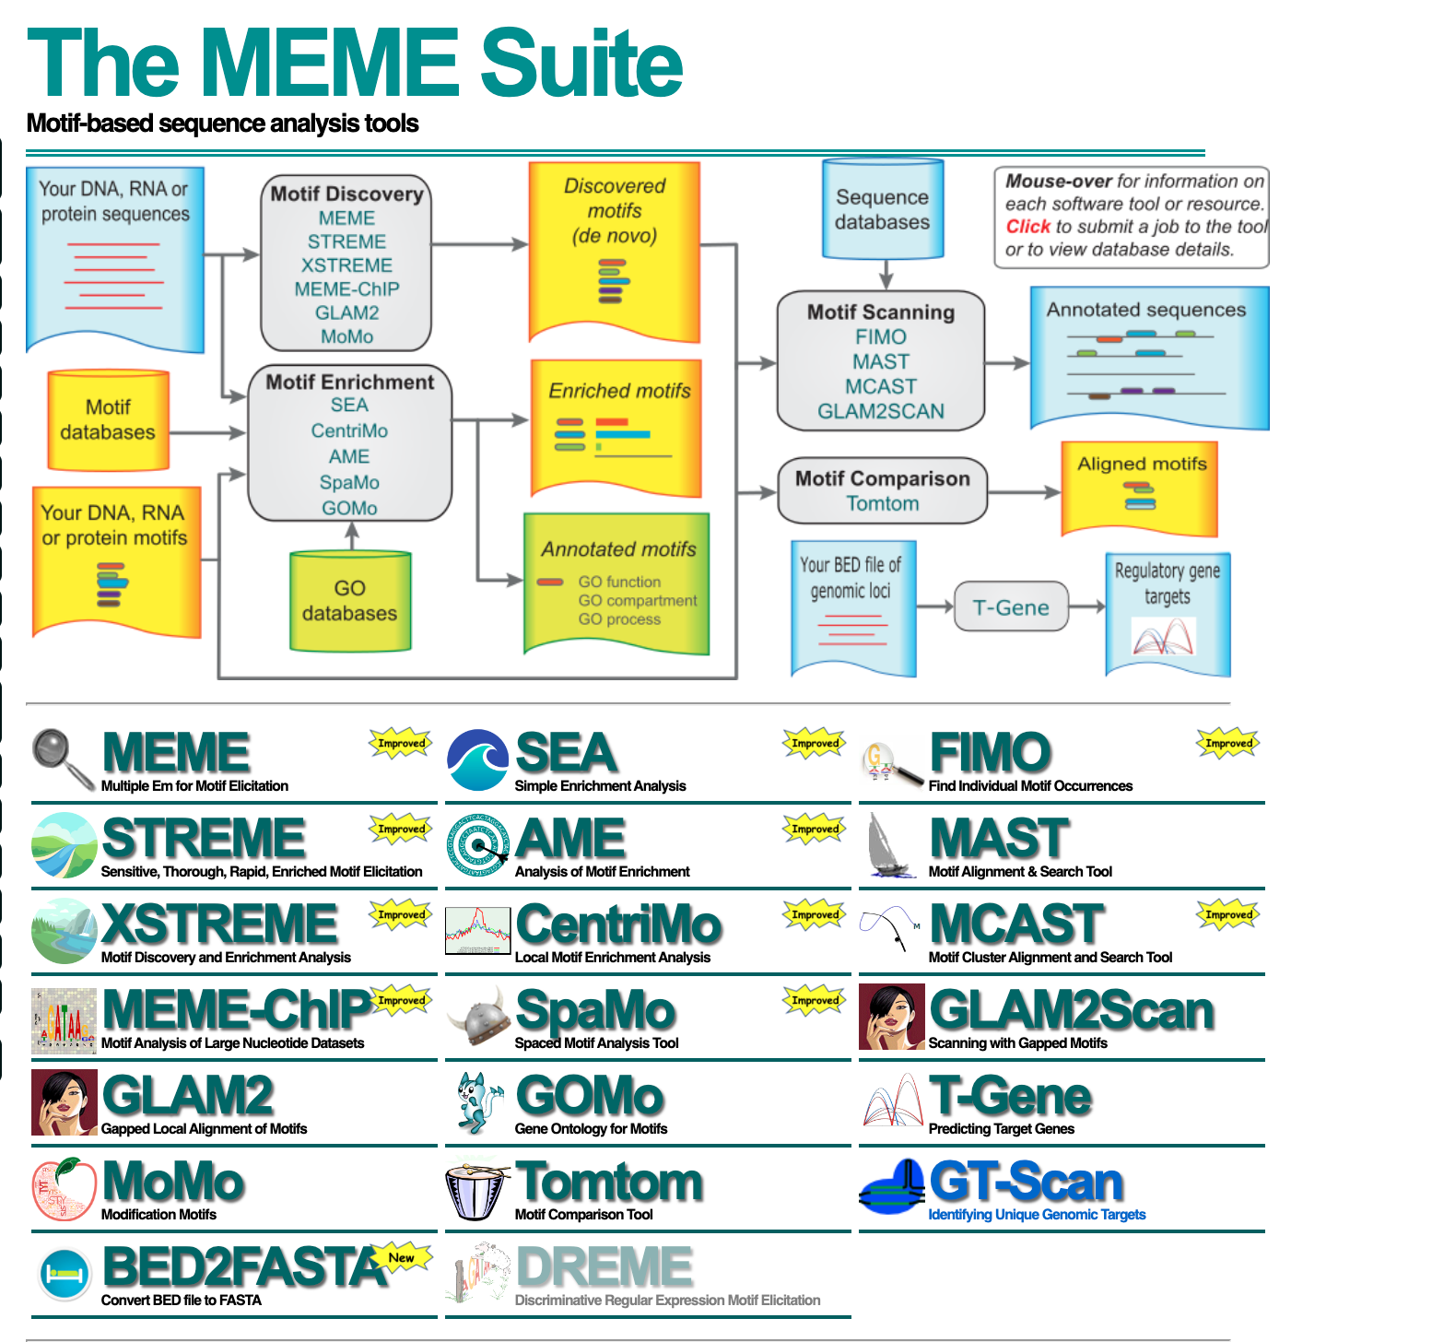
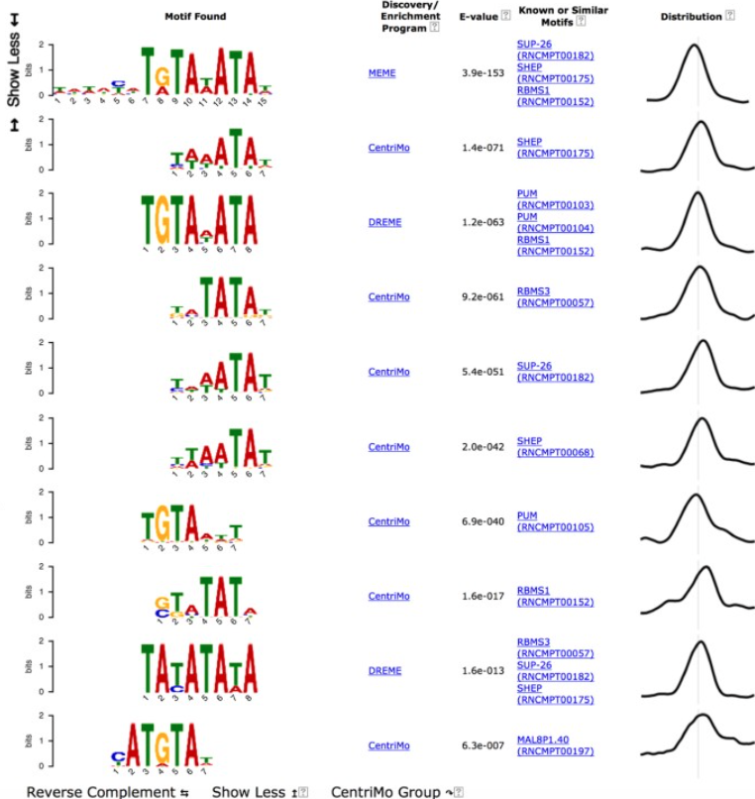
MOTIF enrichment
UCSC mammalian genome
hg38

Slide 32
Remaining plan
Pathway enrichment and sample clustering
Differential analysis
RNA-seq

Slide 33
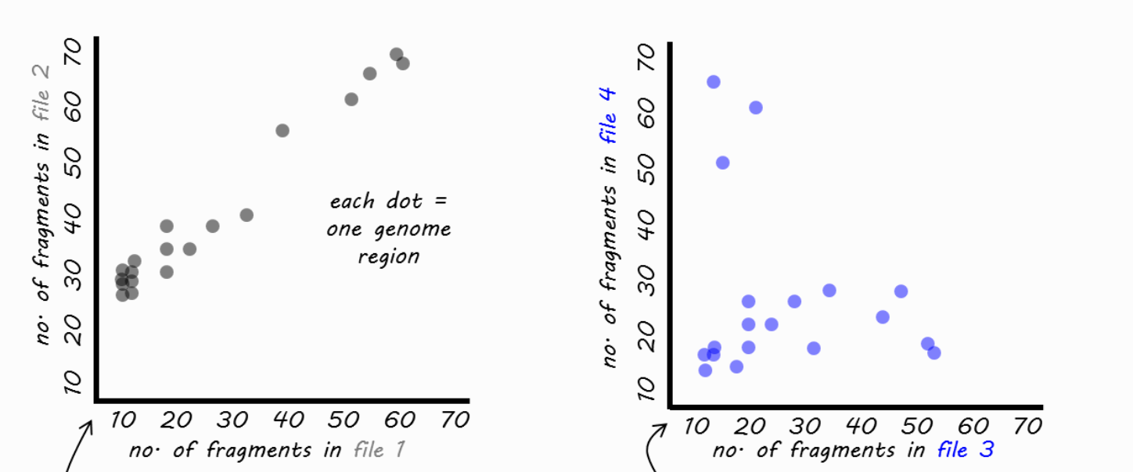
Sample clustering
Map bam coverage
module load anaconda3/personal
conda install -c bioconda deeptools
multiBamSummary bins --bamfiles /rds/general/user/jr2715/home/mda_training/hacat_bg4_Rep1.bl.dedup.sort.bam /rds/general/user/jr2715/home/mda_training/hacat_bg4_Rep2.bl.dedup.sort.bam --outFileName multiBamArray_hacat_bg4.npz --binSize=5000 --extendReads 75 --labels bg4_1 bg4_2
Visualize correlation
plotCorrelation --corData multiBamArray_hacat_bg4.npz --plotFile bg4_hacat.pdf --outFileCorMatrix bg4_hacat_matrix.txt --whatToPlot heatmap --corMethod spearman

Slide 34
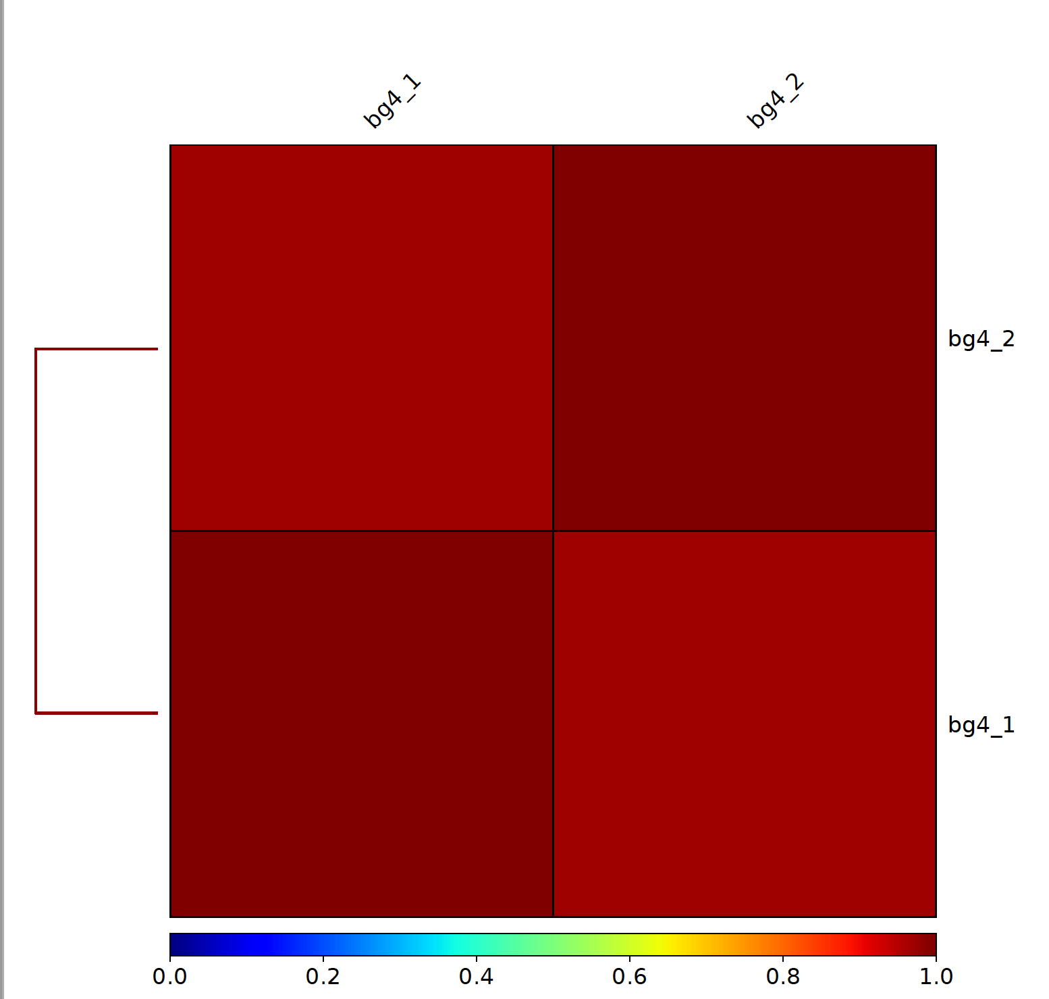
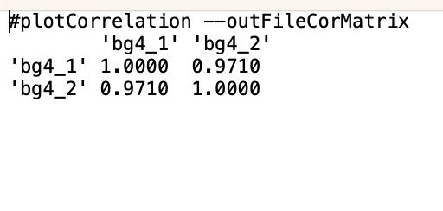
Sample clustering

Slide 35




Pathway enrichment
Analysis tool -> paste genes -> continue
Molecular signatures database -> investigate
Max 500 genes

Slide 36
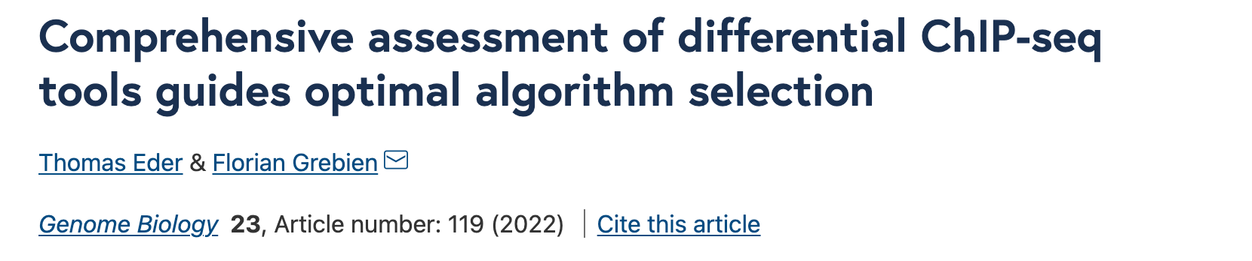
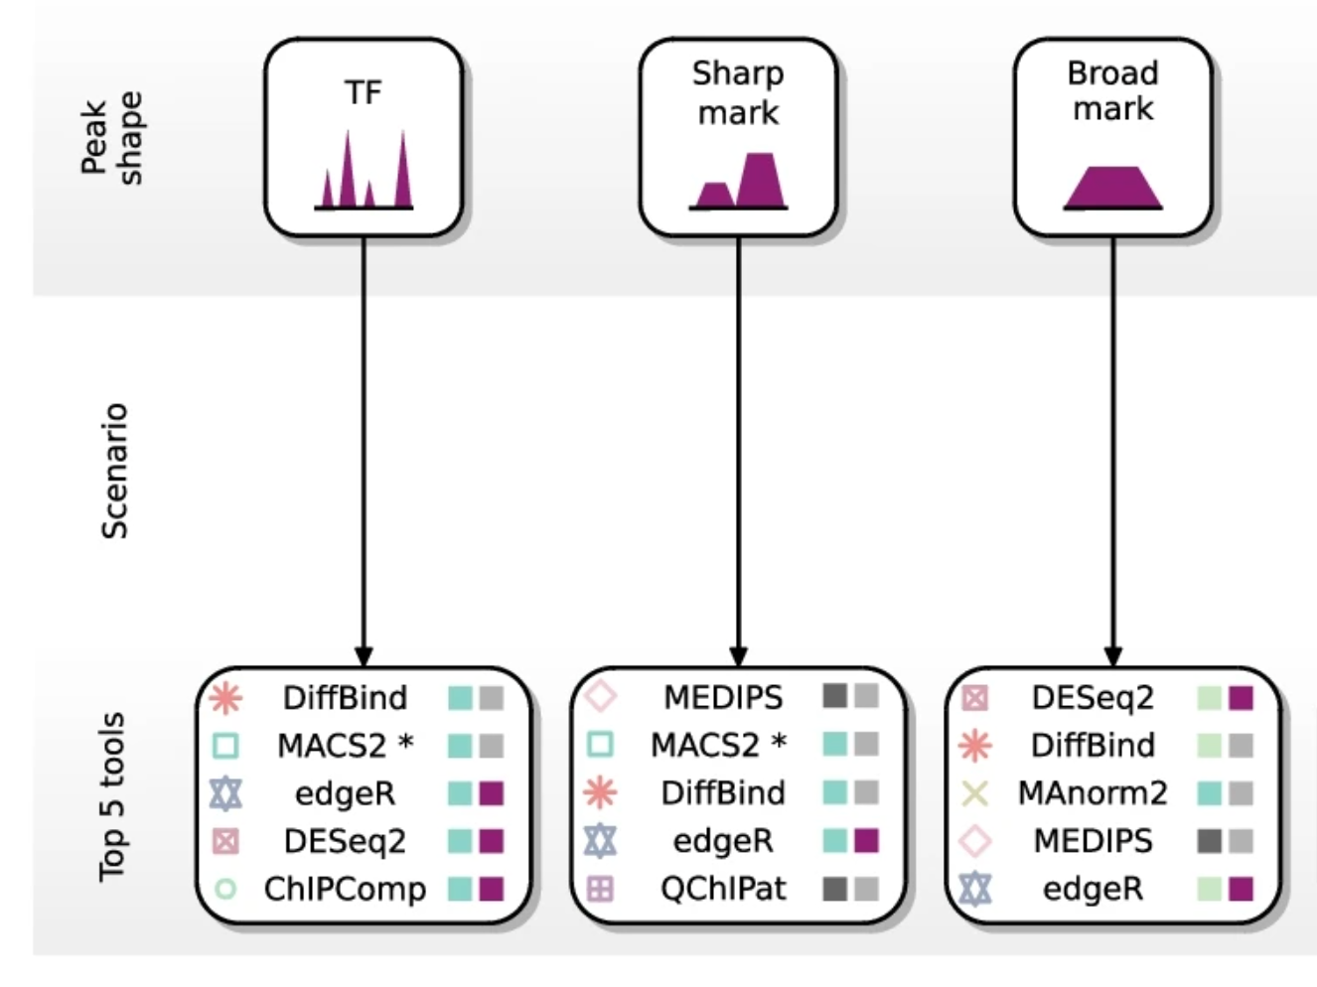
Differential expression

Slide 37

Differential expression
Download and set-up R-Studio
install.packages("BiocManager")
install.packages("tidyverse")
BiocManager::install("DiffBind")
library(DiffBind)

Slide 38
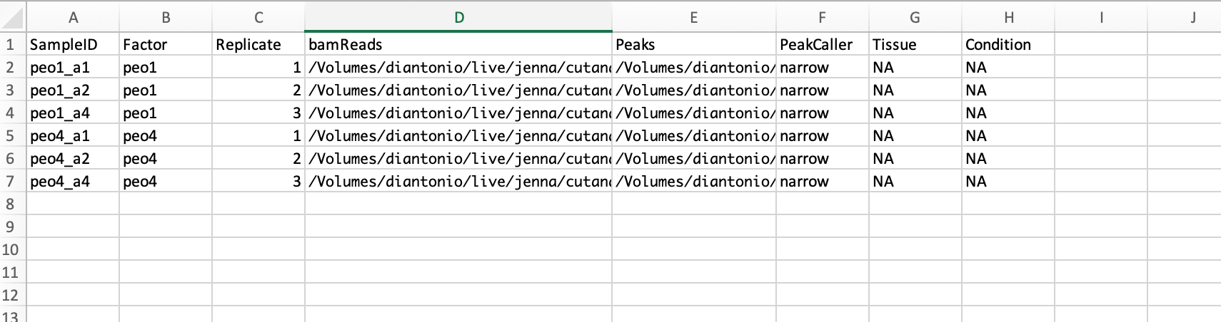
Differential expression
Create sample sheet
.csv file

Slide 39
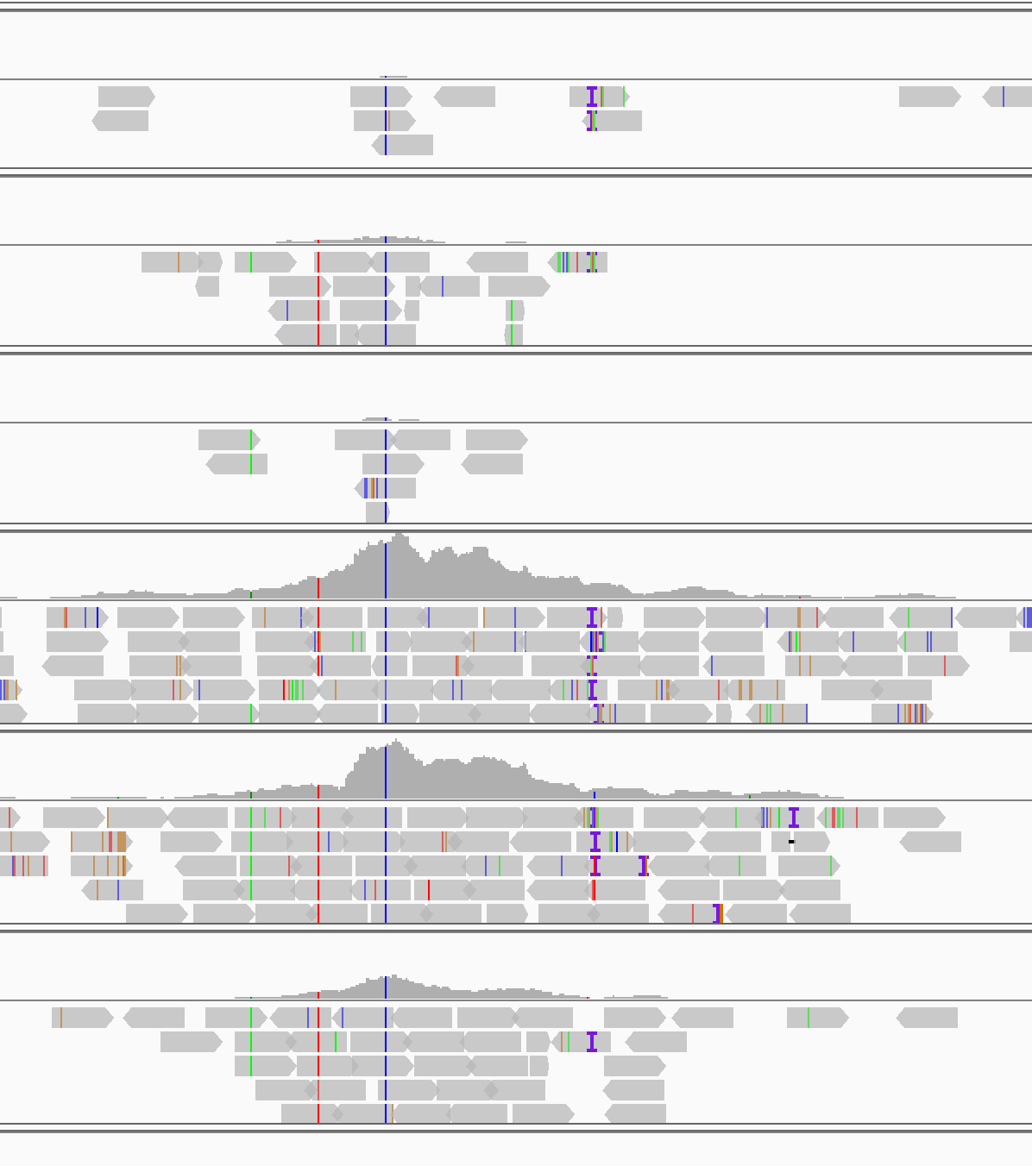
Differential expression
Run diffbind
#run diffbind
h3k27ac_DE <- dba.analyze(”h3k27ac_sample_sheet.csv")
#save report
h3k27ac_DE.DB <- dba.report(h3k27ac_DE)
#write report to file
write.csv(h3k27ac_DE.DB, "h3k27ac_DE_report.csv")
PEO1
PEO4
Notes:
Latest powerpoint
Deseq2
Star

Slide 40
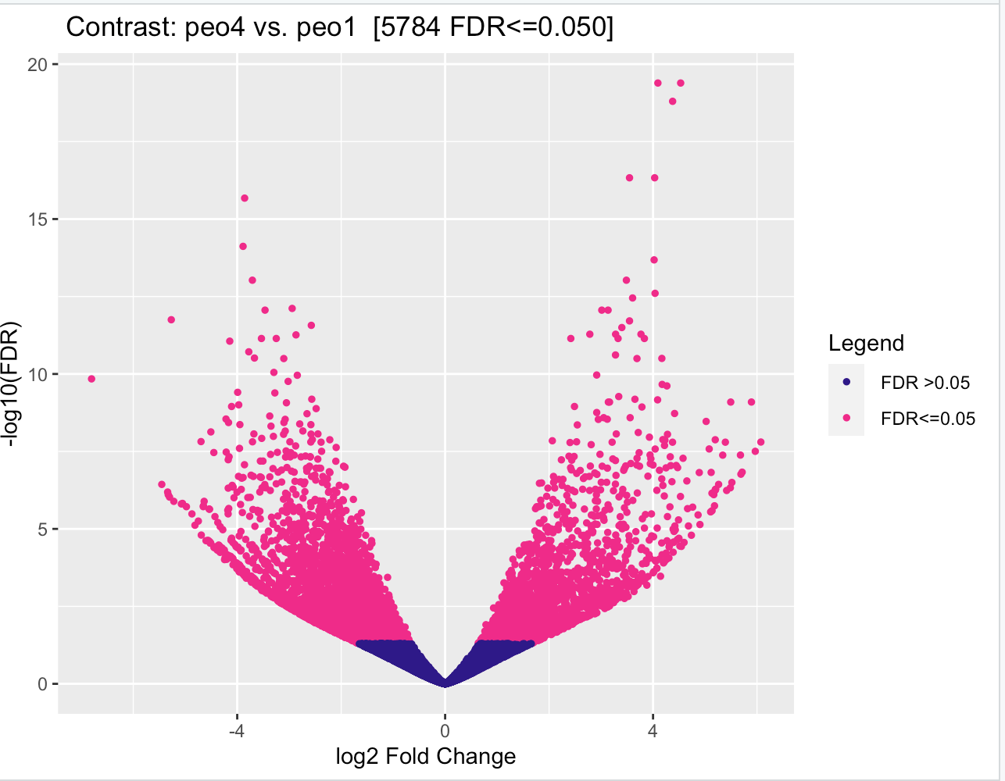
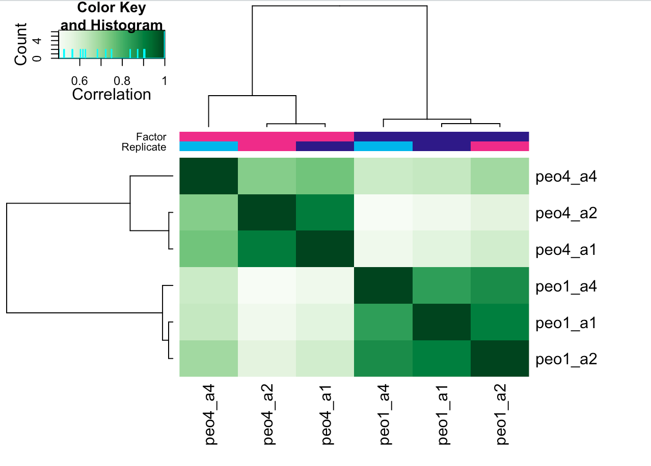
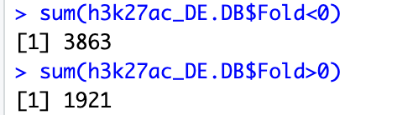
Differential expression
Diffbind output examples – see manual for details
#volcano plot
dba.plotVolcano(h3k27ac_DE)
#sample clustering
plot(h3k27ac_DE)
Count up or down

Slide 41
RNA-seq analysis
Pipeline
Fastqc
Trim reads (optional)
Align to genome with splice aware algorithm (e.g. STAR)
Differential analysis with DESeq2

Slide 42
RNA-seq analysis
Align with star
module load star
for name in peo1_1 peo1_2 peo1_3
do STAR --runThreadN 12 \
--genomeDir /rds/general/project/diantonio/live/tools/star \
--sjdbGTFfile /rds/general/project/diantonio/live/tools/genomes/hg38_ucsc/hg38.refGene.gtf \
--sjdbOverhang 149 \
--outFileNamePrefix $name \
--readFilesCommand gunzip -c \
--readFilesIn $PBS_O_WORKDIR/../fastq/trimmed_$name.R1.fq.gz $PBS_O_WORKDIR/../fastq/trimmed_$name.R2.fq.gz \ --outSAMtype BAM SortedByCoordinate
done

Slide 43
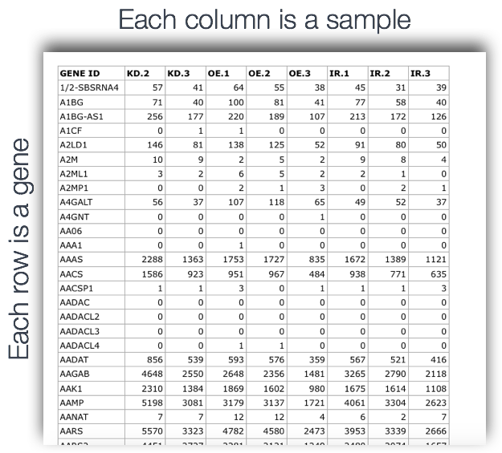
RNA-seq analysis
DESeq2
# make feature count table
nice R
library(Rsubread)
fc_PEO_RNA <- featureCounts(files=list.files(pattern='.bam$'),annot.ext='/data/jr2715/PEO1_4/RNA_seq/star/Homo_sapiens.GRCh38.104.gtf',isGTFAnnotationFile=TRUE, nthread=32, GTF.featureType="exon", GTF.attrType="gene_id", useMetaFeatures=TRUE, isPairedEnd=T)
#define comparison
condition <- c("PEO1", "PEO1", "PEO1", "PEO4", "PEO4", "PEO4")
#run DESeq2
dds <- DESeq(dds)
#extract results
res <- results(dds)

Slide 44

Conclusion
Outline
Command line basics
2. Quality over quantity: fastqc and adaptor trimming
3. Alignment (or finding where things belong)
4. Peak calling: ain’t no mountain high enough
5. Differential analysis
6. The rest of it: annotation, pathway enrichment and more ✨
Analysis code and useful resources can be found at:
https://github.com/jennarobinson99/MDA_bioinformatics
Congrats you did it!

